Slide 1
Class/Object Relationships Dependency, Association
CS(217) Object Oriented Programming
Abeeda Akram

Slide 2
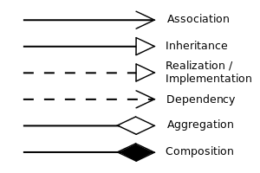
Relationship between Objects
Dependency (use-a)
Association (use-a)
Aggregation (has-a)
Composition (whole-part)
Inheritance (is-a)

Slide 3
Dependency (use-a)
Very weak relation
Object of one class uses objects of other class for a short amount of time (in a function) to perform a specific task
Change in used object will effect the dependent object
Life time (creation and destruction) of objects is independent
Unidirectional relation, used class object is unaware of dependent class
Class A
Class B
Uses some functions of

Slide 4

Dependency (use-a) Example
ostream and istream objects are used in operator functions.
friend istream& operator>> (istream& , Point&);
friend ostream& operator<< (ostream& , const Point&);
ostream and istream object are neither created inside class object, nor they are related to the object
Life time (creation and destruction) of Point, ostream and istream is independent
Unidirectional
istream and ostream classes are unaware of existence of Point class and its objects,
but Point class is aware of the use in operator functions
Point
ostream
Point
istream
Uses stream functions of ostream
Uses stream functions of istream

Slide 5



Association (use-a)
Weak relation, no ownership of objects is involved
Object of one class can be associated with object(s) of other class(s) for performing some tasks
one-to-one,
one-to-many
many-to-many
Objects have independent life time (creation and destruction)
Objects are unrelated to one another
Objects may or may not know about the existence of the object
Unidirectional
Bidirectional

Slide 6

Association (use-a) Examples
Student
Borrow
Book
One-to-Many relation, one student can borrow many books from a library.
No owner ship and lifetime is involved in this relationship.
A list of ids of borrowed books can be added to student.
class student{
private:
int sId;
int *borrowedBooks;
//Maintain the list of borrowed books
public:
void borrowABook(const int & bid);
void ReturnABook(const int & bid);
};

Slide 7



Association (use-a) Examples
Course
Prerequisite
Course
Reflexive association
One-to-Many relation, one course can have many prerequisite courses.
No owner ship and lifetime is involved in this relationship.
How to link courses?
A list of ids of prerequisite courses can be added to course.
class course{
private:
int cId;
int *prerequisiteCourses;
//Maintain the list of prerequisites
public:
void AddPrerequisite(const int & cid);
void RemovePrerequisite(const int & cid);
};

Slide 8






Association (use-a) Examples
Driver
Drive
Car
One-to-Many relation, one driver can drive many cars.
A list of ids of derived cars can be added to driver class.
class driver{
private:
int dId;
int *derivingCars;
//Maintain the list of derived cars
public:
void AddCar(const int & cid);
void RemoveCar(const int & cid);
};

Slide 9
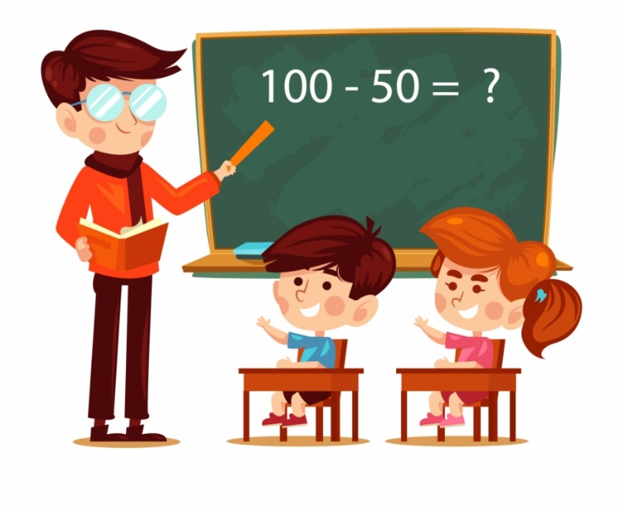










Association (use-a) Examples
Teacher
Teach
Course
Registered
Student
How to link teacher, course and student in the system?
One teacher can teach many courses
In one course many students are registered
Add courses list in teacher
Add student’s ids list in a course

Slide 10

Association (use-a) Examples
Doctor
Examine
Patient
Patient
visit
Doctor
Unidirectional one to many
A doctor can examine many patients to earn money.
class Doctor{
private:
int dId;
int *pateintsExamined;
//Maintain the history of examined patients
public:
void examinPatient(const int & pid);
};
Unidirectional one to many
A patient can visit many doctors for different ailments.
class Patient {
private:
int pId;
int* visitedDoctors;
//Maintain the history of patient on every visit a docotor
public:
void visitDoctor(const int & did);
};

Slide 11
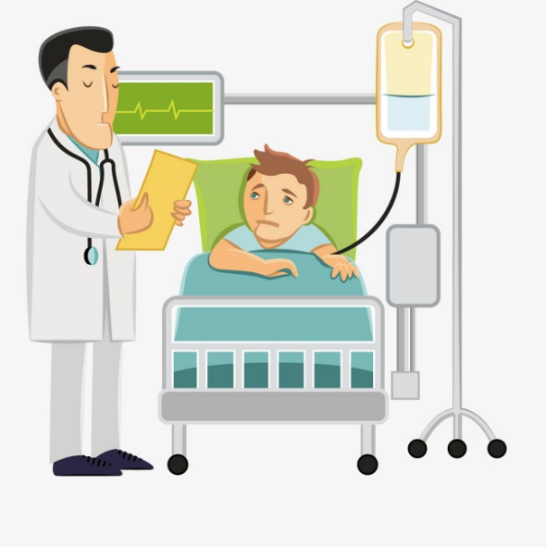

Association (use-a) Examples
Doctor
Patient
Many-to-Many relation.
Bidirectional, doctor knows patient and patient knows doctor.
A doctor can examine many patients.
A patient can visit many doctors for different ailments.
No owner ship and lifetime is involved in this relationship.
How to link doctor and patient in system?
Add ids of examined patients in doctor object?
Add ids of visited doctors in patient object?

Slide 12

Association (use-a) Examples
Doctor
Perform
Medical Checkup
get
Patient
Bidirectional many to many, breakdown in two one to many relations.
Add association relation as a new class.
Store id of doctor and patient for each checkup.
Add checkups list in both doctor and patient to link them.
A doctor can perform many checkups
A patient can get many checkups
class Checkup{
private:
int dId;
int pId;
int checkupId;
//Maintain the doctor and patient ID
public:
CheckUp(const int & pid, const int & did);
};

Slide 13
















Association (use-a) Examples
Drives
Rides
Driver
Car
Rider
A driver can drive different cars.
A rider can ride different cars with different drivers.
A car can be used by different riders and drivers.
Ternary Relation: How to link driver, car and rider in the system?
Add an association class Ride.
Add id of driver, car and rider for a ride.
Add rides list in driver, rider and car.
Driver
Pick
Ride
Book
Rider
Used
Car

Slide 14

Summary
Dependency (use-a)
Association (use-a)
Class A
Class B
Uses some functions of
Driver
Drive
Car
Course
Prerequisite
Course
Doctor
Perform
Medical Checkup
get
Patient

